Slide 1
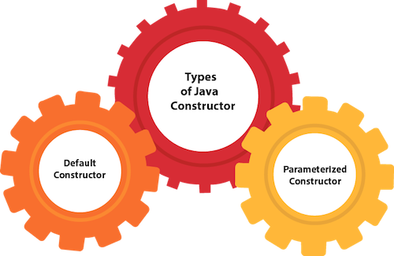

What is Constructor???

Slide 2
Constructor has same name as class name and it look like this in java code
Public class MyClass
{
//This is the constructor
MyClass()
{
}
}

Slide 3
How does constructor work???
public class Hello { String name; //Constructor Hello(){ this.name = "BeginnersBook.com"; } public static void main(String[] args) { Hello obj = new Hello(); System.out.println(obj.name); } }

Slide 4
Types Of Constructor
Default
No-arg constructor
Parameterized.

Slide 5
Default Constructor
If you do not implement any constructor in your class, Java compiler inserts a default constructor into your code on your behalf. This constructor is known as default constructor.
Public class
{
Public static void main(String args[])
{
MyClass obj=new MyClass();
}
}

Slide 6
No-arg Constructor
Constructor with no arguments is known as no-arg constructor. The signature is same as default constructor, however body can have any code unlike default constructor where the body of the constructor is empty.
class Demo {
public Demo
{ System.out.println("This is a no argument constructor");
} public static void main(String args[])
{ new Demo();
} }

Slide 7
Parameterized constructor
Constructor with arguments(or you can say parameters) is known as Parameterized constructor.

Slide 8
public class Employee { int empId; String empName; //parameterized constructor with two parameters Employee(int id, String name){ this.empId = id; this.empName = name; } void info(){ System.out.println("Id: "+empId+" Name: "+empName); } public static void main(String args[]){ Employee obj1 = new Employee(10245,"Chaitanya"); Employee obj2 = new Employee(92232,"Negan"); obj1.info(); obj2.info(); } }

